Slide 1
Combinational Logic
Chapter 4
Imran Siddiqi
imran.siddiqi@mcs.edu.pk
Computer Science Department
College of Telecommunication Engineering
National University of Sciences and Technology

Slide 2
Combinational Circuits
1. Combinational
2. Sequential
LOGIC CIRCUITS:
Combinational logic circuits (circuits without a memory):
A combinational circuit consists of gates whose outputs at any time depend only on the current combination of inputs.
Sequential logic circuits (circuits with memory):
In sequential circuits, the outputs depend on the current inputs
and the previous inputs. These networks employ storage elements and logic gates. [Chapters 5 and 9]

Slide 3
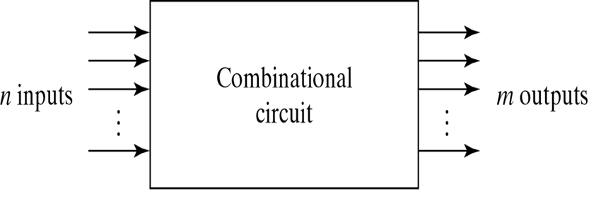
Combinational Circuits
Block Diagram of Combinational Circuit

Slide 4
Combinational Circuits
Most important standard combinational circuits are:
  Adders
  Subtractors
  Comparators
  Decoders
  Encoders
  Multiplexers
Available in IC’s as MSI

Slide 5
Analysis of Combinational Circuits
Two Approaches
  Create Intermediate Equations / Boolean Functions
  Create Intermediate Truth Tables
Example
A
B
C
Out
A
B
C’

Slide 6
Analysis Procedure – Approach 1
Procedure
  Label Intermediate outputs, these are gate outputs that are function of input variables (Level 1)
  Next Label gate outputs that are function of input vairables and other gate outputs (Level 2)
  Repeat till all outputs are labeled (Level n)
Example
A
R
B
C
Out
S
T
A
B
C’

Slide 7
Analysis Procedure – Approach 1
R = A B C
S = A + B
A
R
B
C
Out
S
T
A
B
C’

Slide 8
Analysis Procedure – Approach 1
R = A B C
S = A + B
T = S C’
Out = R + T
A
R
B
C
Out
S
T
A
B
C’

Slide 9
Analysis Procedure – Approach 1
Substitute previously defined functions and obtain the output Boolean function in terms of input variables.
  R = A B C
  S = A + B
  T = S C’ = (A + B) C’
  Out = R + T = A B C + (A + B) C’
A
R
B
C
Out
S
T
A
B
C’

Slide 10
Analysis Procedure – Approach 2
Step 1 (Determine total number of input variables)
  For n input variables there are 2^{n} input combinations.
A | B | C
0 | 0 | 0
0 | 0 | 1
0 | 1 | 0
0 | 1 | 1
1 | 0 | 0
1 | 0 | 1
1 | 1 | 0
1 | 1 | 1
A
B
C
Out
A
B
C’

Slide 11
Analysis Procedure – Approach 2
Step 2
  Label all gate outputs.
A
R
B
C
Out
S
T
A
B
C’

Slide 12
Analysis Procedure – Approach 2
Step 3
  Generate Truth Table for each level
A | B | C | R | S | T | Out
0 | 0 | 0 | 0 | 0 | 0 | 0
0 | 0 | 1 | 0 | 0 | 0 | 0
0 | 1 | 0 | 0 | 1 | 1 | 1
0 | 1 | 1 | 0 | 1 | 0 | 0
1 | 0 | 0 | 0 | 1 | 1 | 1
1 | 0 | 1 | 0 | 1 | 0 | 0
1 | 1 | 0 | 0 | 1 | 1 | 1
1 | 1 | 1 | 1 | 1 | 0 | 1
A
R
B
C
Out
S
T
A
B
C’

Slide 13
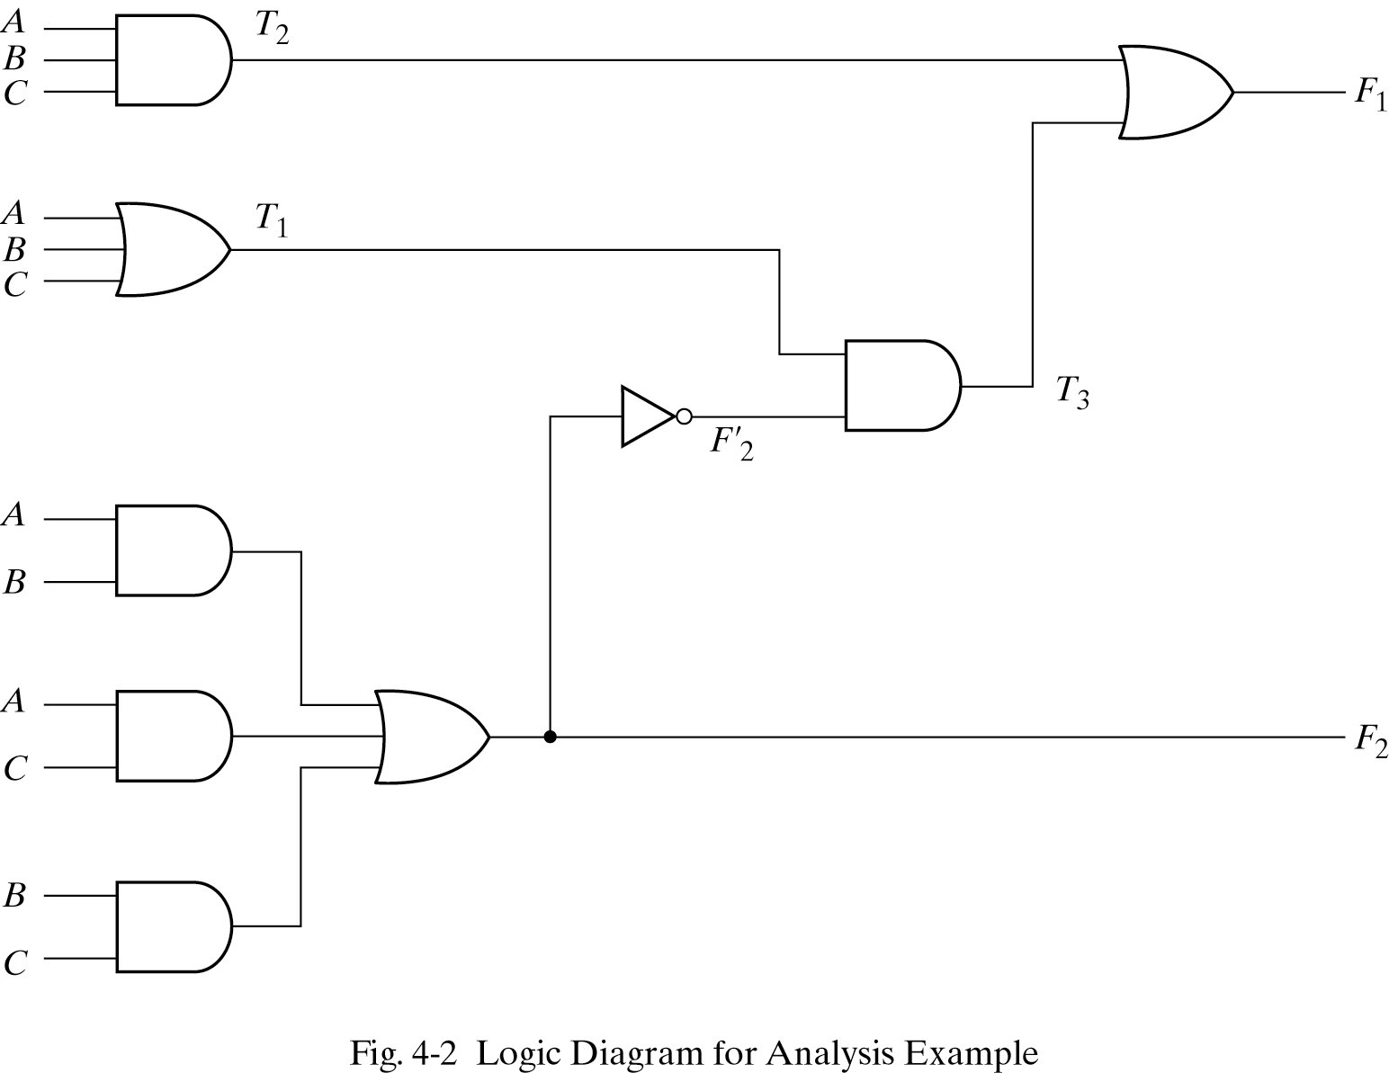





Example 2: Analysis

Slide 14
Example 2: Analysis
  Approach 1 Approach 2
  T2= A B C
  T1 = A + B +C
  F2=AB+BC+AC
  T3=T1 F2’
  = (A+B+C)(AB+BC+AC)’
  =(A+B+C)(A’+B’)(A’+C’)(B’+C’)
  F1= T3 + T2
  =(A+B+C)(A’+B’)(A’+C’)(B’+C’)+ABC
  =A’BC’+A’B’C+AB’C’+ABC
A | B | C | T1 | T2 | F2 | T3 | F1
0 | 0 | 0 | 0 | 0 | 0 | 0 | 0
0 | 0 | 1 | 1 | 0 | 0 | 1 | 1
0 | 1 | 0 | 1 | 0 | 0 | 1 | 1
0 | 1 | 1 | 1 | 0 | 1 | 0 | 0
1 | 0 | 0 | 1 | 0 | 0 | 1 | 1
1 | 0 | 1 | 1 | 0 | 1 | 0 | 0
1 | 1 | 0 | 1 | 0 | 1 | 0 | 0
1 | 1 | 1 | 1 | 1 | 1 | 0 | 1

Slide 15
Designing a Combinational Circuit
From the Specification of the circuit, determine the number of inputs and output – Assign a symbol to each
Derive the Truth Table that defines required relationship between inputs and outputs
Obtain (simplified) Boolean function for each output as a function of the input variable
Draw the logic diagram and verify the correctness of the design

Slide 16
Circuit Design - Example
BCD to Excess-3 Code Converter
Specification
  Transforms BCD code for the decimal digits to Excess-3 code for the decimal digits
  BCD code words for digits 0 through 9: 4-bit patterns 0000 to 1001, respectively
  Excess-3 code words for digits 0 through 9: 4-bit patterns consisting of 3 (binary 0011) added to each BCD code word
  4-Inputs & 4-outputs

Slide 17
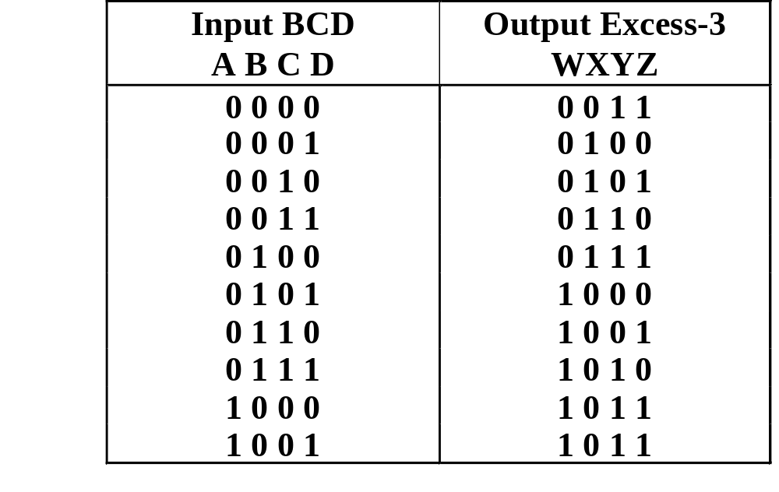
Circuit Design - Example
BCD to Excess-3 Code Converter
Truth Table
BCD:
A,B,C,D
Excess-3
W,X,Y,Z
Don’t Cares
- BCD 1010
to 1111
1 1 0 0

Slide 18
Circuit Design - Example
z | 00 | 01 | 11 | 10
00 | 1 | 0 | 0 | 1
01 | 1 | 0 | 0 | 1
11 | X | X | X | X
10 | 1 | 0 | X | X
y | 00 | 01 | 11 | 10
00 | 1 | 0 | 1 | 0
01 | 1 | 0 | 1 | 0
11 | X | X | X | X
10 | 1 | 0 | X | X
Boolean Function
z=D’
y=CD+C’D’
x | 00 | 01 | 11 | 10
00 | 0 | 1 | 1 | 1
01 | 1 | 0 | 0 | 0
11 | X | X | X | X
10 | 0 | 1 | X | X
w | 00 | 01 | 11 | 10
00 | 0 | 0 | 0 | 0
01 | 0 | 1 | 1 | 1
11 | X | X | X | X
10 | 1 | 1 | X | X
x=B’C+B’D+BC’D’ =B’(C+D)+BC’D’
w=A+BC+BD = A+B(C+D)

Slide 19
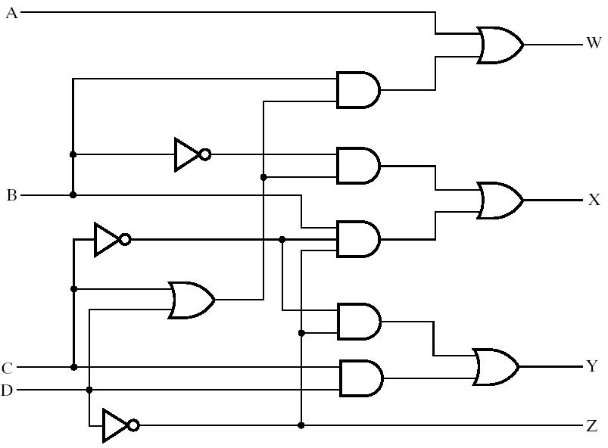
Circuit Design - Example
Circuit Diagram

Slide 20
Circuit Design - Example
Find the circuit truth table from the equations and compare to specification truth table:
Input BCD
Output Excess
Input BCD
-
3
Output Excess
-
3
A B C D
WXYZ
A B C D
WXYZ
0 0 0 0
0 0 1 1
0 0 0 0
0 0 1 1
0 0 0 1
0 0 0 1
0 1 0 0
0 1 0 0
Verification
0 0 1 0
0 0 1 0
0 1 0 1
0 1 0 1
0 0 1 1
0 1 1 0
0 0 1 1
0 1 1 0
0 1 0 0
0 1 1 1
0 1 0 0
0 1 1 1
0 1 0 1
1 0 0 0
0 1 0 1
1 0 0 0
0 1 1 0
1 0 0 1
0 1 1 0
1 0 0 1
0 1 1 1
1 0 1 0
0 1 1 1
1 0 1 0
1 0 0 0
1 0 1 1
1 0 0 0
1 0 1 1
1 0 0 1
1 0 1 1
1 0 0 1
1 0 1 1
The tables match!
Chapter 3 - Part 1 <number>
Notes:
Since the outputs are not specified for the don’t cares, no analysis for correctness is needed.

Slide 21

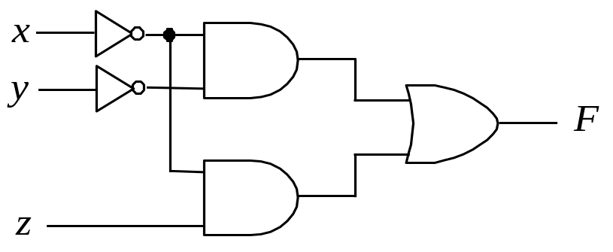
Circuit Design – Example 2
Design a circuit with three inputs and one output. The output is a 1 when the binary value is less than three. The output is 0 otherwise.
y
y z
x | y | z | F
0 | 0 | 0 | 1
0 | 0 | 1 | 1
0 | 1 | 0 | 1
0 | 1 | 1 | 0
1 | 0 | 0 | 0
1 | 0 | 1 | 0
1 | 1 | 0 | 0
1 | 1 | 1 | 0
00 01 11 10
0
1 | 1 |  | 1
x
1
z

Slide 22
References
Chapter 4 – Digital Design Morris Mano
Logic and Computer Design Fundamentals, 4e, Power Point Slides, 2008 Pearson Education Inc.
Digital Design – Amirali Baniasadi
Material in these slides has been taken from, the following resources

